Slide 1
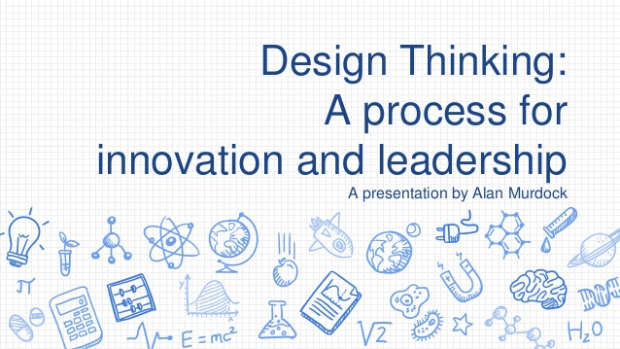
A presentation by Bhavika Dhingra

Slide 2
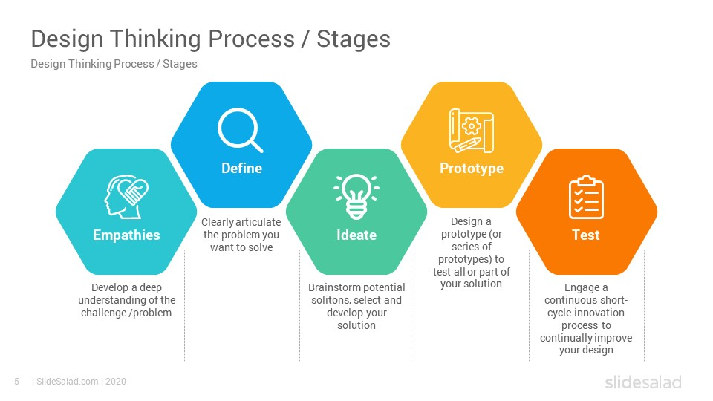
In order to build a design we need to go through the stages mentioned above. The major challenge Is to define a problem, and after defining the problem we need to ideate different solutions and select the best possible solution and develop it.

Slide 3
My Design Thinking Journey!!
While sitting back at home at the time of pandemic and being a passionate reader I was out of books and was confused which book to read, which genre to select, and all I wanted to access my library and wanted my library teacher to recommend me some books. But I was helpless.
So after brainstorming several ideas with my brother to solve this problem of mine we reached to point and got a solution to this problem i.e School Library Delivery and Recommendation app and I named the app as Reading Hub.

Slide 4
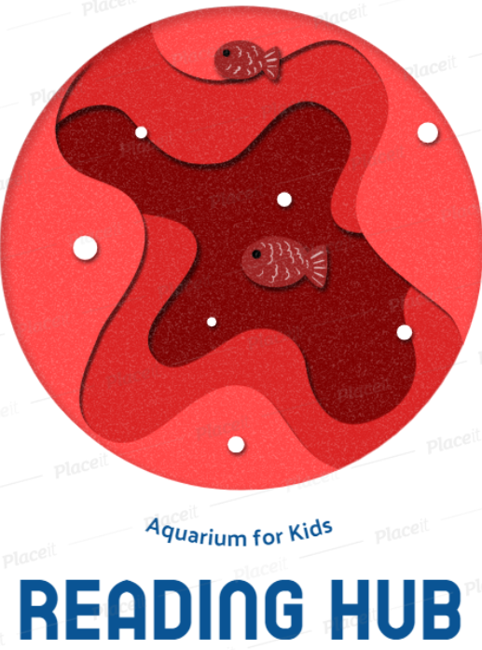
Reading Hub
Reading Hub is an ultimate platform with an ocean of books- also called aquarium for kids. It has access to thousands of e-books, delivery systems for several books from nearby libraries and a recommendation system for confused book readers

Slide 5
How The Product Works
A reader can go through various collection of ebooks. If he/she likes or wants to read any book and if this book is available in nearby libraries a book delivery man would deliver the book to the reader. The reader only has to pay a certain amount for security and a delivery processing fee and he/she gets a book for 21 days.
The recommendation system works by knowing preferences of the reader and recommend a new book in every 2 week.

Slide 6
Advantages
This product solves problems for readers. Major advantages of this product
An all in one book access platform.
Free to use.
Easy to use.
Solves problems of confused readers using a book recommendation system.

Slide 7
Cost
We need several tie-ups in nearby libraries we are focusing mainly schools, so the cost of book for us is nil. While the delivery fees is paid by the reader.
The Library would be getting a joining bonus and they will get some amount for each issued book from their library.
The main cost to build this platform is for app development and server deployments.
We would be earning profit on this model, by starting a monthly subscription fees after a certain target of users are hit.

Slide 8
Thank You
We would love to hear your constructive
views

